Slide 1
Unit 6
The Open Economy

Slide 2


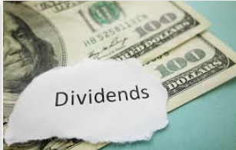

Topic 6.1 Balance of Payment Accounts
Balance of Payments (BOP) is an accounting system to keep track of transactions between countries over a period of time.
As we first saw in the circular flow model, money enters and leaves the economy through injections and leakages. The balance of payments looks at these flows and categorizes the flows into two categories – the current account and capital account.
Summary
All movements of money between countries are classified either in the current account or capital/financial account.
Balance of Payments (BOP)
Current Account (CA)
Net exports
Net Investment income
Net Transfers
Money transfers
Net unilateral transfers
Capital and Financial Account
Net purchase of assets between countries
Net Financial capital transfers
Whenever there is a transaction between our country and another, we should ask: “Is it in the current account or capital account?”

Slide 3
Current Account
Summary
Current account = flow of money for trade, income and transfers
Current account surplus = more money enters
Current account deficit = more money leaves
The current account includes net exports (X-M) but also two other categories of money flows.
Net Imports and Exports (Net Exports, Trade Balance)
Exports – income entering the country (G&S leaving the country)
Imports – income leaving the country (G&S entering the country)
Net Factor Incomes (from ownership of land, capital and enterprise)
Eg. A businessman owns property in another country and receives rent from their tenants.
Eg. A French woman own shares in Apple and receives a dividend each year.
Any income you receive from overseas, such as dividends (share of profit) from stocks is counted in the current account.
Net Transfers
Remittances – Eg. A taxi driver in Australia sends money home to his family in Ukraine.
Foreign Aid – Eg. South Korea donates money to Japan after a large earthquake destroys many buildings.

Slide 4




Current Account Balance
Summary
The current account includes net exports, net income, net transfers.
Current Account Surplus
More money enters the country.
This could mean:
High value of exports (goods flow out but money flows in)
High levels of income from abroad
High levels of transfers into the country
Current Account Deficit
More money leaves the country
This could mean:
High value of imports and low exports
Paying a lot of income to foreign countries
High levels of transfers out of the country
Net exports
Net income
Net transfers

Slide 5
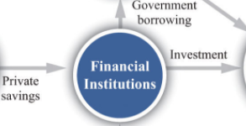
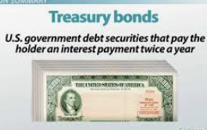


Capital Account / Financial Account
Summary
The capital and financial account includes financial investments and real investments.
The capital account represents the balance of investment. Investment can take many forms, including financial asset investment and investment in non-financial assets.
Net Financial Investments
Stocks, Bonds, Other financial assets
Buying and selling of stocks and bonds would move money in and out of the country.
Net Real Investments
Foreign Direct Investment (eg. factories, retail stores which are owned by the foreign company but operated locally)
Land (eg. A wealthy US family buys property in Mexico)
Property and Equipment (eg. A businessperson buys trucks which he rents to a delivery company.)
Nike Inc using its own money (financial capital) to open up its own store is an example of Foreign Direct Investment FDI
A foreign owned mining company would need to invest in equipment and machinery which would be a real investment inflow.

Slide 6
Capital and Financial Account Balance
Summary
There is a capital and financial account balance.
Capital Account Surplus
More money enters the country.
This could mean:
High value of investment in the local economy by foreigners
Financial assets
Real Assets
Capital Account Deficit
More money leaves the country
This could mean:
High value of investment by locals in foreign countries
Investment
Investment

Slide 7
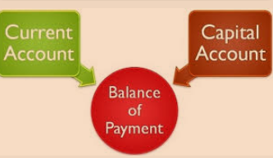

Balance of Payments = 0
Summary
Current account + Capital and Financial Account = 0
The balance of payments = 0 = Current Account + Capital and Financial Account
The money that enters the country must be equal to the money that leaves the country.
Increase in the CA balance must be offset by a decrease in the CFA balance
Increase in the CFA balance must be offset by a decrease in the CA balance.

Slide 8
Current/Capital Account Surplus/Deficits
Summary
When one account is in deficit the other must be in surplus and vice versa.
Because the balance of payments = 0, then:
If the current account is in surplus, the other must be in deficit.
If the current account is in deficit, the other must be in surplus.
Current Account | Capital Account | Real World Example
Surplus Exports > Imports | Deficit More investment in foreign countries than in domestic markets. | China exports many products to other countries, and Chinese are using this money to invest in property etc. in these countries. A lot of property in Sydney, Australia is owned by Chinese investors.
Deficit Imports > Exports | Surplus More investment in foreign countries than in domestic markets. | The US imports more than it exports. Many foreigners lend money to the US and invest in US companies and property as well as lending to the US government by buying bonds.

Slide 9
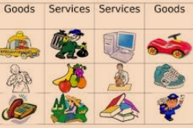
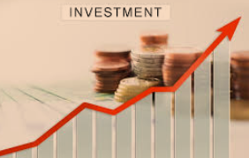
Balance of Payments = Current Account + Capital Account = 0
Balance of Payments Summary
In the long run the balance of money going in and out of the country is always equal!
Current Account
Net Imports and Exports
Net Factor Incomes (from ownership of land, capital and enterprise)
Net Transfers
Remittances
Foreign Aid
Capital Account / Financial Account
Net Financial Investments
Stocks, Bonds, Other financial assets
Net Real Investments
Foreign Direct Investment (eg. factories, retail stores)
Property and Equipment
Surplus = positive
Deficit = negative
Credit vs Debit
Debit = Credit = money entering the country – Think: Extra credit
money leaving the country – Think: D = down

Slide 10
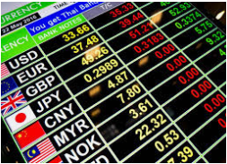
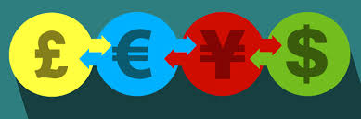
The Exchange Rate
The exchange rate is simply the value of currency A relative to another currency B.
Eg. 1 USD = 6.5RMB or 1RMB = 0.15USD
The exchange rate is determined by the foreign exchange market which we will cover in the very next chapter.
In this market, one currency is exchanged for another.

Slide 11

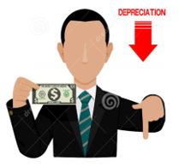
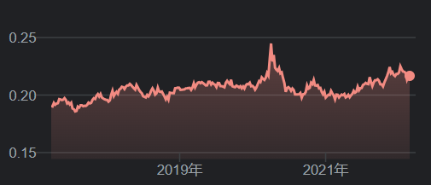
Exchange Rate Movements
The value of a currency can, and often changes.
We can use the following terms to explain these changes.
Appreciate = go up in value eg. RMB can buy more AUD
Depreciate = go down in value eg. RMB can buy less AUD
Exchange Rate Fluctuations = the upward (appreciation) and downward (depreciation) movements that occur over time
Note: When currency A appreciates relative to currency B, currency B therefore depreciates relative to currency A.
Currency Appreciation:
When the currency becomes more valuable in terms of other currencies.
Currency Depreciation
When a currency becomes less valuable in terms of other currencies.
Summary
Appreciation = currency becomes more valuable
Depreciation = currency becomes less valuable

Slide 12


Appreciation and Depreciation Consequences Summarized
Appreciation
= ↑Purchasing Power →↑Imports ↓Exports
→Benefits for some individuals
Locals buying imports from foreign countries
People living abroad being paid in your currency
Foreigners sending money back home
→Negative outcomes for some individuals
Exporters lose out because their products are more expensive
Depreciation
= ↓Purchasing Power → ↓Imports ↑Exports
→Benefits for some individuals
Foreigners buying your exports
Therefore exporters benefit because their products are cheaper
Foreigners investing in your country

Slide 13
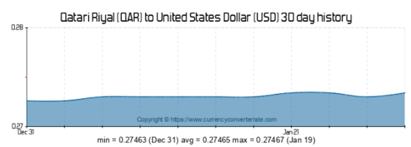
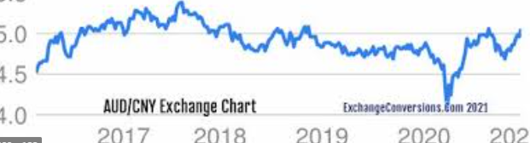
Floating vs Fixed Exchange Rates
Governments can choose to control the exchange rate or allow it to fluctuate. These two exchange rate systems are given these two names.
Note: Floating exchange rates are far more common and therefore our default assumption is that questions will concern floating exchange rates.
Fixed = the government controls the exchange rate
Floating = the government allows market forces to decide the exchange rate
Managed float = the government allows market forces to dictate the price but also intervenes when it wishes
Eg. Italy was accused of manipulating their exchange rate so that local firms had an advantage in exporting
The AUD fluctuates in value compared to the Chinese Currency CNY/RMB.
This is a floating exchange rate system.
Eg. The Qatari currency is set to the USD.
This is a fixed exchange rate system.

Slide 14


Exchange Rate Summary
Appreciation = ↑Purchasing Power
Who benefits:
People travelling to other countries
People buying imports
People investing in other countries
People on fixed incomes, living overseas.
Depreciation = ↓Purchasing Power
Who benefits:
Exporters whose goods are now cheaper for foreigners
Foreign investors in the country
The exchange rate is simply the value of currency A relative to another currency B.
Eg. 1 USD = 6.5RMB or 1RMB = 0.15USD
Fixed = the government controls the exchange rate
Floating = the government allows market forces to decide the exchange rate
Appreciate = go up in value eg. RMB can buy more AUD
Depreciate = go down in value eg. RMB can buy less AUD

Slide 15
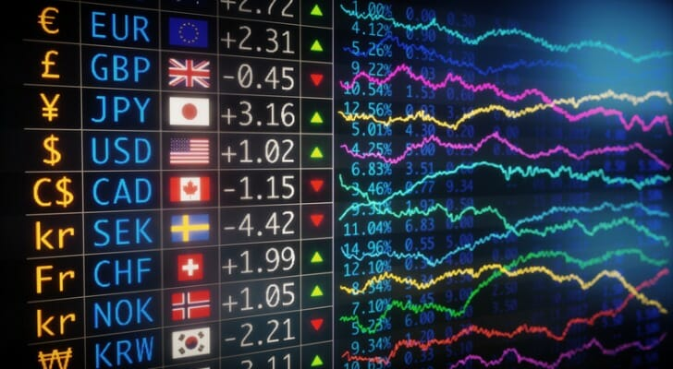
Foreign Exchange Market – ‘Forex Market’
What is the foreign exchange market?
A market is simply a place where buyers and sellers come together whether in a physical space, or increasingly in online spaces.
The foreign exchange rate market is a place where buyers and sellers exchange currency of one country for the currency of another
This determines the equilibrium exchange rate in a flexible exchange market and influences the flow of goods, services and financial capital between countries.
We can call the foreign exchange market the Forex market for short.

Slide 16
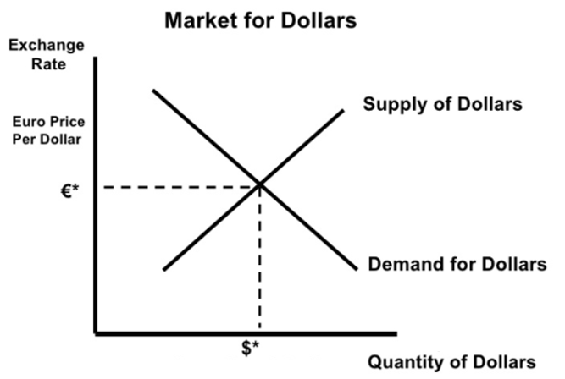
Exchange Rate Graph
The exchange rate graph is a new graph but it is the same as any standard demand and supply graph.
Demand is the demand of people to have money in that currency. Eg. You wish to buy $100 US Dollars for a holiday.
Supply is individuals wanting to give up their currency in exchange for another. Eg. An American wants to give away their US dollars in exchange for Euros.
The price is given in terms of the other currency because when we talk about the price of US dollars we need to talk about how much we give up to buy 1 US dollar.
The Last Major Graph in AP Macro!
Price Axis: We can see that the value of US dollars (USD) is given in terms of Euros (EUR). This is the exchange rate.
Therefore we can show appreciation and depreciation on this axis.
Appreciation
Depreciation
Quantity Axis: This shows the quantity of Dollars that are being demanded and supplied

Slide 17
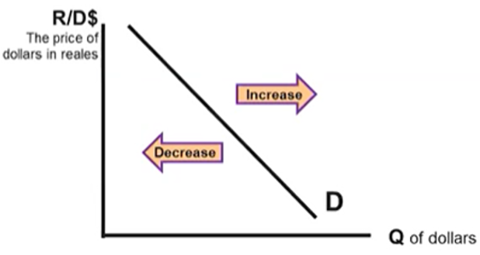
Determinants of currency demand:
Tastes and Preferences
If the demand for a country’s exports increase, the demand for the currency also increases. This may occur if their products become more popular.
Investors may also have preferences for investing in property or other investments, therefore increasing or decreasing demand for that currency.
5. Changes in trade policies
An increase in tariffs results in a lower demand for imports from the foreign country. As a result, the demand for foreign currency decreases, and the foreign currency depreciates.
6. Expected Future Exchange Rates
Higher future exchange rates increase demand and lower expected future exchange rates decreases demand. This is what we refer to as speculation because there
2. Income
When individuals have higher incomes, they will tend to purchase a wider variety of goods including imports.
Therefore, if income level increases in a country B they will buy more of country A’s exports. Therefore they will demand more of currency A.
3. Interest Rates
If the interest rate increases in country A, then foreign inestors will want to put more of their money in country A. Therefore they will demand more of currency A.
4. Price Level (Inflation)
If a country has issues with inflation then people will be less likely to hold that currency because the value will decrease over time.
Furthermore, countries with high inflation tend to be less stable overall, discouraging investors and reducing the demand of that currency.

Slide 18
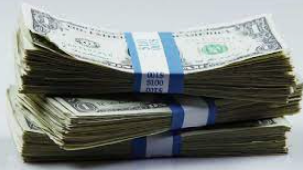

Two Meanings of Capital
Summary
Capital = equipment and machines
Capital = money
Somewhat confusingly, capital can take on slightly different meanings depending on the context, similar to many words in English (eg. Lunch break vs break computer, Wrist watch vs watch TV etc.)
Capital = Equipment and Machines
If you see the terms:
Capital stock
Capital formation
Capital goods
Investment in capital
This refers to equipment and machines which firms use to help produce goods.
Capital = money
If you see the terms:
Capital inflows/outflows
Foreign capital
This refers to money which is lent to businesses and used by businesses.

Slide 19



Capital Flow Questions – the highest interest rate wins!
Investors like to put their money where they get highest returns, including the loanable funds market (ie. lending money and getting paid back with interest)
If the interest rate in a country increases relative to other countries
Investors want to put their money in this country where the returns are highest which will increase demand for that currency.
If the interest rate in a country decreases relative to other countries
Investors want to move their money out of this country and find a higher interest rate which will decrease demand for that currency.
5%
5%
5%
5%
8%
Summary
A country with higher interest rates will attract more capital inflows (investors moving money to that country)

Slide 20
Determinants of Currency Demand
 | Increase | Decrease
Tastes and Preferences | →Buying more G&S from that country→↑D_{currency} | →Buying less G&S from that country→↓D_{currency}
Income Level of other countries | →Buying more G&S from that country as imports→↑D_{currency} | →Buying less G&S from that country as imports→↓D_{currency}
Interest Rates | →investors move more money into that country to earn interest→↑D_{currency} | →investors move less money into that country to earn interest→↓D_{currency}
Price Level (Inflation) | →The value of the money decreases over time (inflation) causing less people to want to hold that currency→↓D_{currency} | →The value of the money increases over time (deflation) causing more people to want to hold that currency→↑D_{currency}
Trade Policies (eg. Taxes on goods you export overseas) | →Your goods are more expensive for foreigners because of the tax→↓D_{currency} | →Your goods are less expensive for foreigners because of the lower tax→↑D_{currency}
Expectations of Future Exchange Rate | →investors want to buy that currency now and sell in the future after it goes up→↑D_{currency} | →investors do not want to buy that currency now because they think it will go down in the future→↓D_{currency}

Slide 21
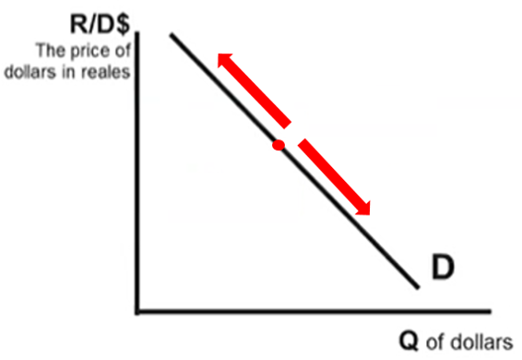
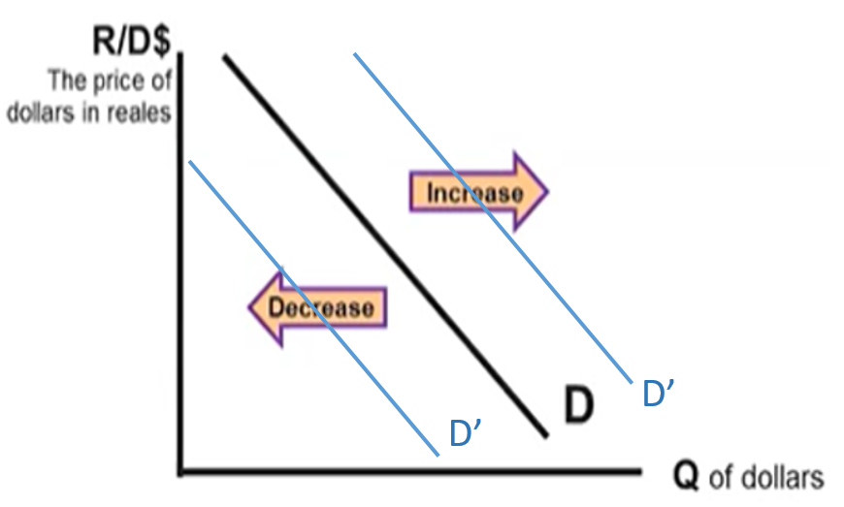
Movement Along the Currency Demand Curve
Shifts of Currency Demand
Causes
Change of price/exchange rate
Determinants of Demand
Tastes and Preferences
Income Level
Interest Rates
Price Level (Inflation)
Trade Policies (eg. Taxes on imports)
Expectations of Future Exchange Rate

Slide 22
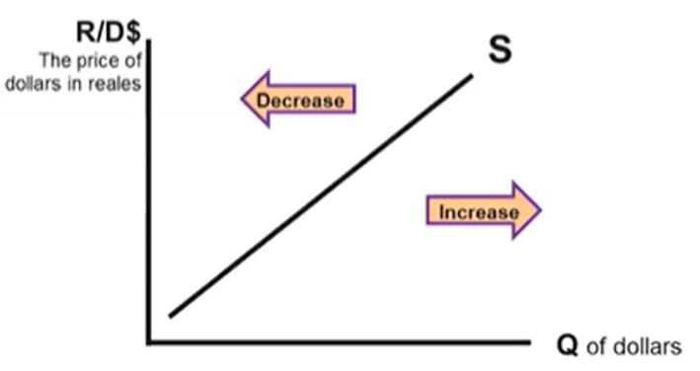
Determinants of Currency Supply
Determinants of Demand AND Supply
Tastes and Preferences
Income Level
Interest Rates
Price Level (Inflation)
Trade Policies (eg. Taxes on imports)
Expectations of Future Exchange Rate
Instead of creating a separate list of determinants for supply we can simply look at the determinants of demand, and reverse them.
This is because the:
Demand for currency A = Supply for currency B.
Every time we make a decision to buy another currency, we have to give up another currency.
Therefore the determinants of currency supply for currency A are the same as the determinants of currency demand for currency B, but reversed.
Eg. The popularity of exports from country A →↑Demand_{currencyA}, ↑Supply_{currencyB}
↓Interest Rates_{CountryA} →↓Demand_{currencyA}, ↓Supply_{currencyB}
Summary
The same determinants of demand of currency apply to supply of currency.
Why? Demand for currency A = Supply of currency B.

Slide 23
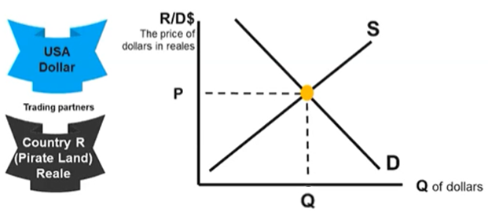
Forex Market Equilibrium
In the foreign exchange market, equilibrium is achieved when the exchange rate is such that the quantity is demanded and supplied of the currency are equal.
Equilibrium point
Equilibrium price
Equilibrium Quantity

Slide 24
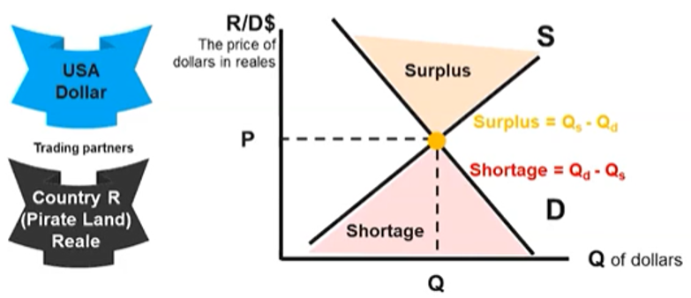
Disequilibrium
How will equilibrium be restored?
Surplus – suppliers will lower their prices to restore equilibrium
Shortage – suppliers will increase their prices to restore equilibrium.
Just like in any market, a price that is too high or low can lead to surpluses and shortages in the foreign exchange market.
A surplus or shortage will automatically be corrected when sellers adjust their prices which drives exchange rates toward equilibrium.
Q_{D}
Q_{S}

Slide 25
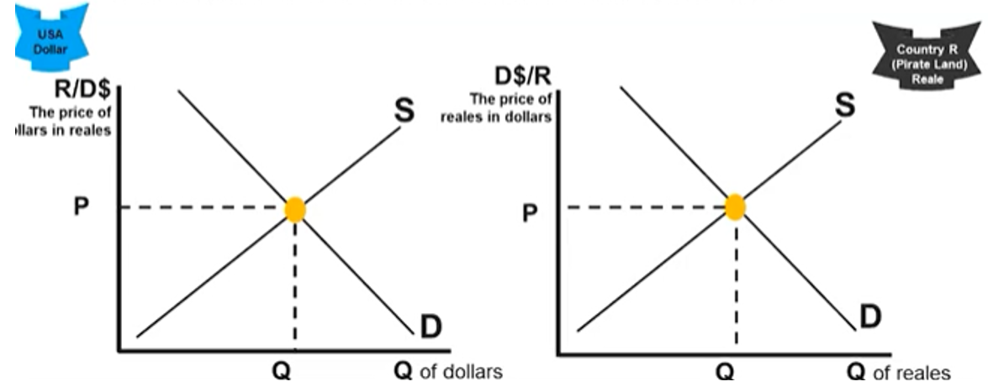
Relationship Between Two Currencies
We have covered the demand and supply of a single currency.
However we often need to consider how movements in one market affect another market.
The rule for this is as follows:
∆Demand of Currency A = ∆ Supply of Currency B
∆Demand of Currency B = ∆ Supply of Currency A
In this case, there is more demand for Dollars.
This means that people are giving up more of their Reales to buy Dollars.

Slide 26
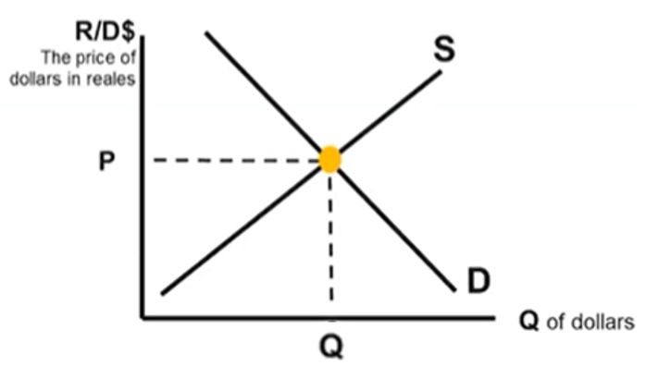
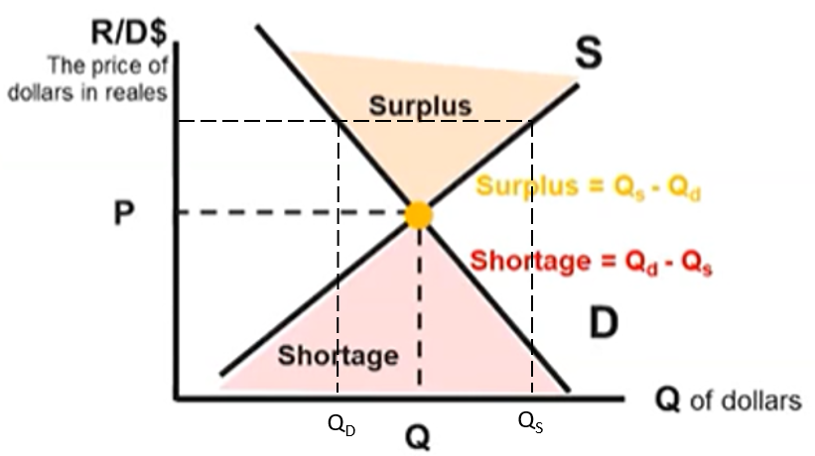
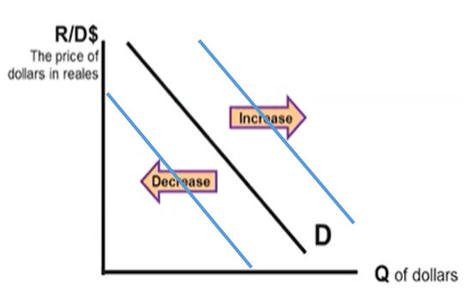
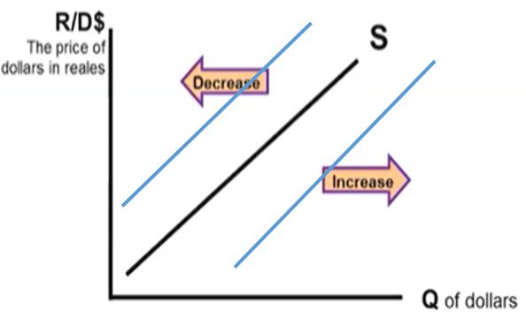
Foreign Exchange Market Summary
The Foreign Exchange Market (Forex market) is where currencies are exchanged and determines the exchange rate/price of currency.
Fixed Exchange rate = exchange rate is constant
Floating exchange rate = moves up and down via market forces
Appreciation
Change in Equilibrium: ↑Demand→↑Price↑Quantity
↓Demand→↓Price↓Quantity
↑Supply→↓Price↑Quantity
↓Supply→↑Price↓Quantity
∆Demand & ∆Supply = either Price or Quantity indeterminate
Depreciation = ↓Purchasing Power → ↓Imports ↑Exports
→Benefits for foreigners buying your currency
Appreciation = ↑Purchasing Power →↑Imports ↓Exports
→Benefits for those buying foreign currencies
Depreciation
Determinants of Demand AND Supply
Tastes and Preferences
Income Level
Interest Rates(affects D and S)
Price Level (Inflation) (affects D and S)
Trade Policies (eg. Taxes on imports)
Expectations of Future Exchange Rate
Surplus and shortage occurs when the price is too high or low.

Slide 27
6.4 The Effect of Changes in Policies and Economic Conditions on the Foreign Exchange Market.
We have defined the foreign exchange market and the factors that cause changes to this market.
We will now examine how the exchange rate and other parts of the macro economy interact.

Slide 28
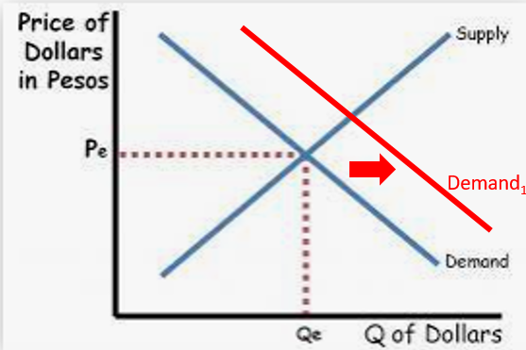
Fiscal Policy, Interest Rates and Exchange Rates
Summary
FP and Exchange Rate are connected because FP affects Interest Rates which affects capital inflows and therefore currency demand.
We previously covered the topic of ‘crowding out’ which showed how Government Fiscal Policy affects the interest rate.
And from our study of the determinants of Currency Demand and Supply, interest rates in the country have an effect on the demand for that currency.
Therefore, there is a connection between a Government’s fiscal policy and its exchange rate.
FP can lead to an appreciation or depreciation of the currency.
Capital inflows means a ↑Demand of that currency which would cause appreciation.
Conversely capital outflows (or a decrease in inflows) means a ↓Demand of that currency which would cause depreciation

Slide 29
FP and MP, Interest Rates, Exchange Rates
FP and MP
Interest Rate
Capital Flows
Exchange Rate
Interest Rate is linked to Exchange rate due to capital flows.
FP and MP is connected to the Interest Rate.
Therefore, FP and MP is connected to the Exchange Rate.

Slide 30
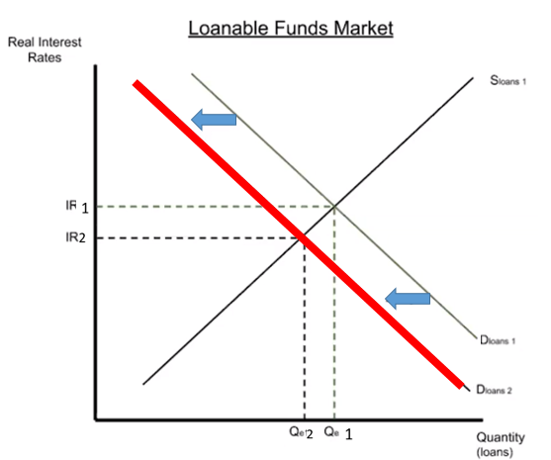
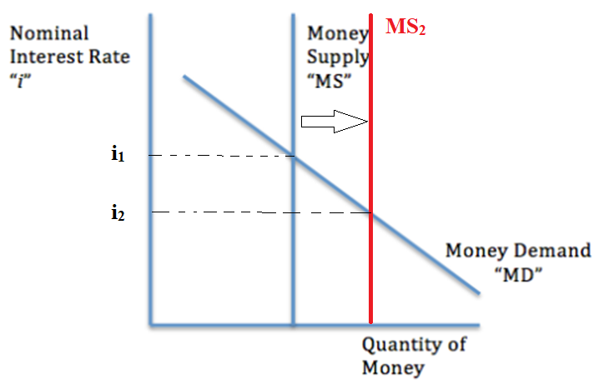
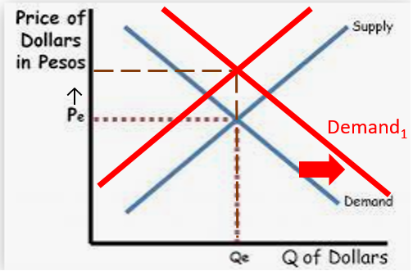
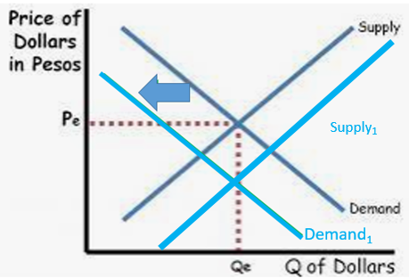
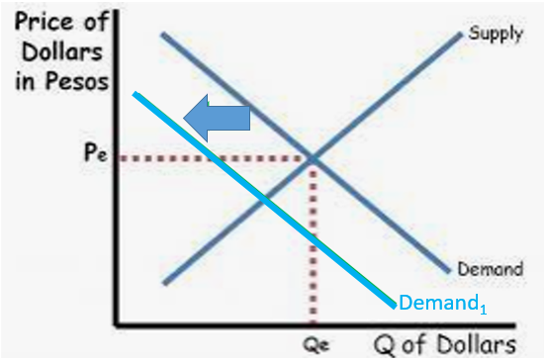
Government Policy, Capital Flows and Exchange Rates
Summary
Expansionary FP→↑Net Capital Inflows→↑ Exchange Rate
Expansionary MP→↓Net Capital Inflows →↓ Exchange Rate
Expansionary fiscal policy→↑Real Interest Rate (crowding out) →↑Net Capital Inflows→↑Exchange Rate
Expansionary MP →↑MS→↓Interest Rate→↓Net Capital Inflows→↓Demand for the currency →↓Exchange Rate

Slide 31
Determinants of Demand/Supply of Currency
Determinants of Demand
Tastes and Preferences
Income Level
Interest Rates
Monetary Policy (Expansionary MP→↓Interest Rate)
Fiscal Policy (Expansionary FP→↑Interest Rate)
Price Level (Inflation)
Trade Policies (eg. Taxes on imports)
Expectations of Future Exchange Rate

Slide 32
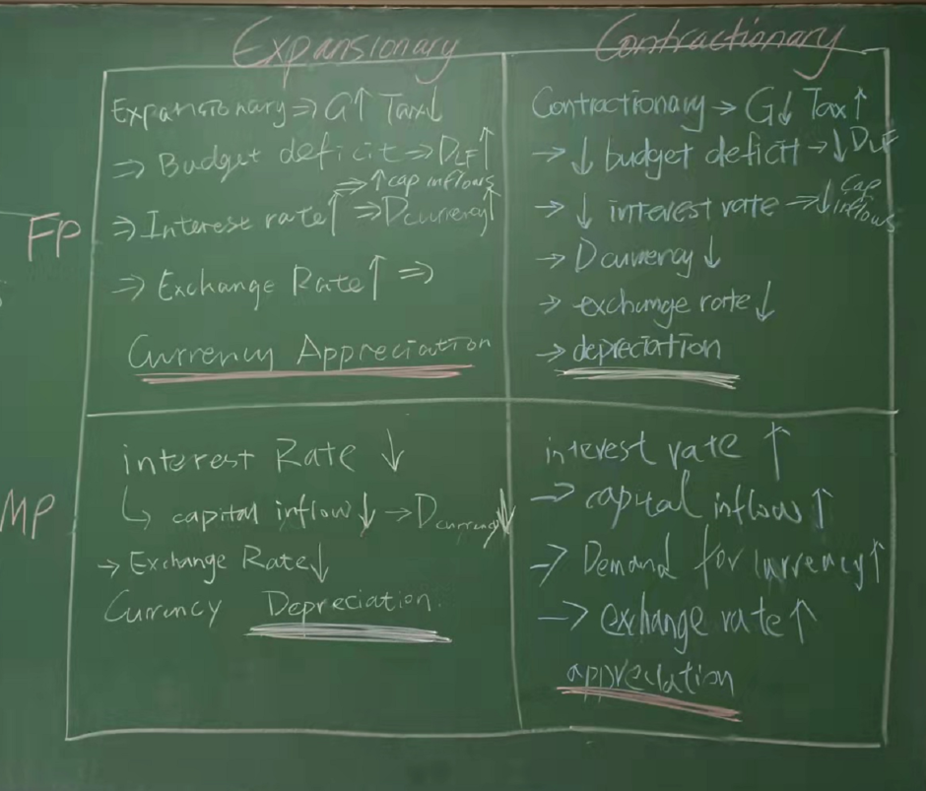

Slide 33
Determinants of Currency Demand
 | Increase | Decrease
Tastes and Preferences | →Buying more G&S from that country→↑D_{currency} | →Buying less G&S from that country→↓D_{currency}
Income Level of other countries | →Buying more G&S from that country as imports→↑D_{currency} | →Buying less G&S from that country as imports→↓D_{currency}
Interest Rates | →investors move more money into that country to earn interest→↑D_{currency} | →investors move less money into that country to earn interest→↓D_{currency}
Price Level (Inflation) | →The value of the money decreases over time (inflation) causing less people to want to hold that currency→↓D_{currency} | →The value of the money increases over time (deflation) causing more people to want to hold that currency→↑D_{currency}
Trade Policies (eg. Taxes on goods you export overseas) | →Your goods are more expensive for foreigners because of the tax→↓D_{currency} | →Your goods are less expensive for foreigners because of the lower tax→↑D_{currency}
Expectations of Future Exchange Rate | →investors want to buy that currency now and sell in the future after it goes up→↑D_{currency} | →investors do not want to buy that currency now because they think it will go down in the future→↓D_{currency}
Fiscal Policy | →Budget Deficit→Government Borrowing→↑D_{LF}→↑D_{currency} | →Budget Surplus→Less Government Borrowing→↓D_{LF}→↓D_{currency}
Monetary Policy | →↓Interest Rates→↓D_{LF}→↑D_{currency} | →↑Interest Rates→↑D_{LF}→↓D_{currency}

Slide 34
Determinants of Currency Supply
 | Increase | Decrease
Note: Demand of Currency A is the same as Supply of Currency B
Income Level of Country B | →Buying more G&S from Country A→↑D_{currencyA} Therefore →↑S_{currencyB} | →Buying less G&S from that country A→↓D_{currencyA} Therefore →↓S_{currencyB}

Slide 35
6.5 Changes in the Foreign Exchange Market and Net Exports

Slide 36
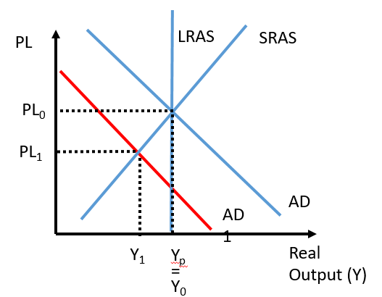
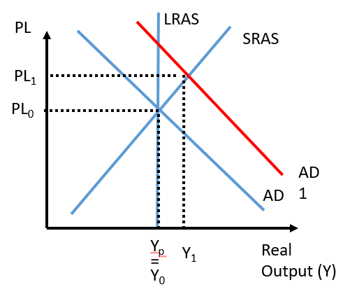
Exchange Rate affects Net Exports, affects AD
Summary
↓Exchange Rate →↑(X-M) →↑AD
↑Exchange Rate → ↓(X-M) → ↓ AD
↑Exchange Rate will lead to a fall in Net exports (↑imports↓exports)
This will lead to a fall in AD.
↓Exchange Rate will lead to a increase in net exports (↑exports↓imports).
This will lead to an increase in AD.
This effect on AD will then have an effect on Output (Y) and Unemployment.
↑Output
↓Unemployment
↓Output
↑Unemployment

Slide 37
FP and MP, Interest Rates, Exchange Rates and Aggregate Demand
Summary
Through this chain of events we can link FP and MP to net exports.
FP and MP
Interest Rate
Capital Flows
Exchange Rate
Net Exports
Aggregate Demand
Aggregate Demand is linked to the exchange rate due to net exports.
Exchange Rate is linked to Interest Rate due to capital flows.
The interest Rate is connected to FP and MP.
Therefore, FP and MP is connected to the net exports and AD.
Note:
FP and MP is already directly linked to AD, but this shows that there is an additional effect on AD that is caused by the effect on the exchange rate.

Slide 38
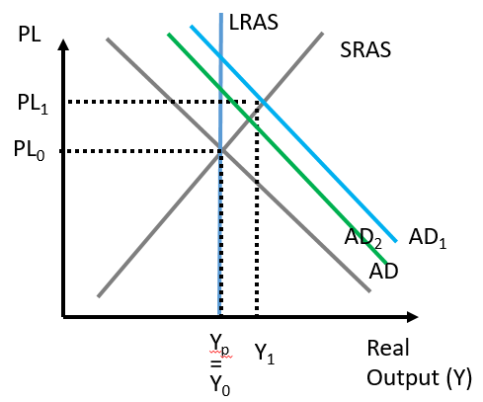
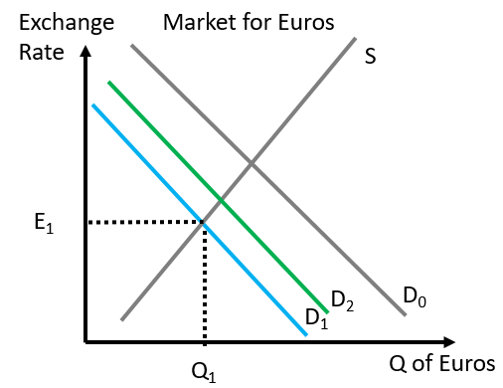
1st, 2nd, 3rd effects etc.
The first increase in AD will outweigh the reduction in AD.
↑AD→↓X-M (wealthier people buy more imports →↓AD
Does this mean that AD is unchanged?
No, AD will increase overall, because the 1st effect will be stronger than the 2nd effect.
↓Exchange Rate (lower demand for currency) →↑X-M (imports more expensive for locals, exports cheaper for foreigners) → ↑Exchange Rate
Again, the 1st effect of the Exchange Rate Effect will be larger than the 2nd effect
Summary
The 1st effect of a movement > the 2nd effect, → a net movement the same as the 1st movement.
The first change in D will outweigh the second change in D.

Slide 39
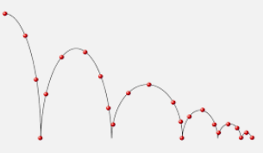

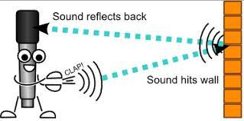
1st, 2nd, 3rd etc. effect - Analogies
A ball’s bounce will eventually find its resting point as the bounces become smaller, similar to movements in the economy.
The ripple will be strongest in the middle and weaker on the outside.
The echo that comes back will be weaker than the initial sound.

Slide 40
6.6 The Exchange Rate, Government Policy and Capital Flows
6.4 focused on the different determinants of demand for currency and how the forex market interacts with other parts of the economy.
6.5 looked at the relationship between exchange rates and net exports and AD.
6.6 will connect 6.4 and 6.5 together and also connect with economic growth from Unit 5.

Slide 41
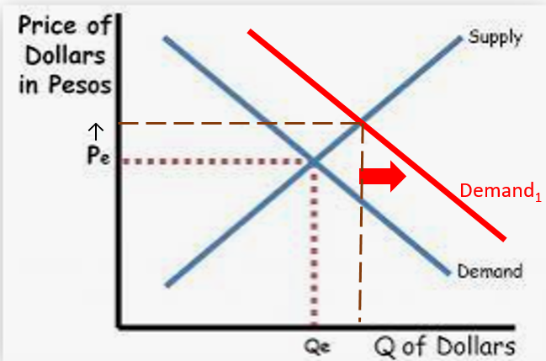
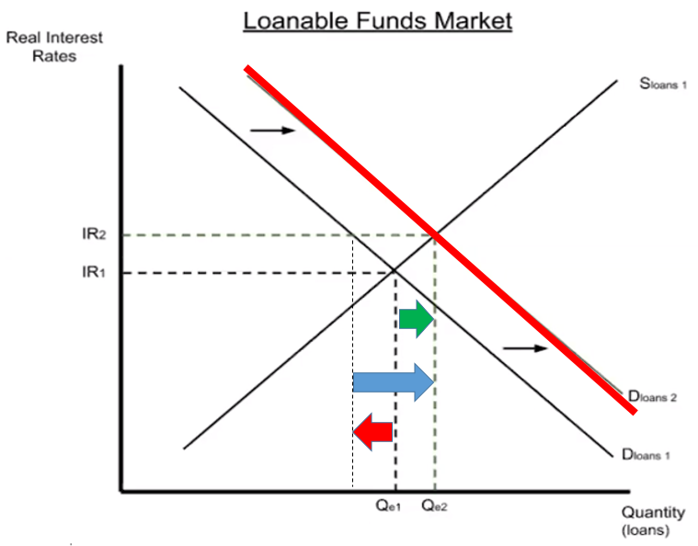
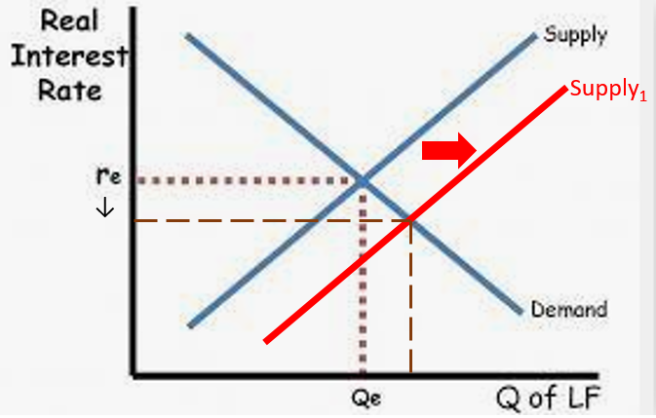
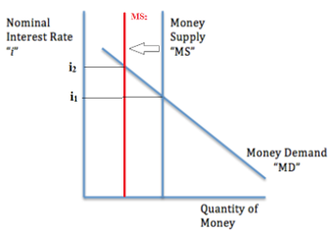
Higher Interest Rates and Capital Inflows
Capital inflows mean increased demand in the foreign exchange market.
Higher interest rates lead to capital inflows.
Investors move their money to where it will earn higher interest
Higher interest can be caused by multiple factors but also includes FP and MP.
Expansionary Fiscal Policy
↑G↓T→↑Government Borrowing→↑D_{LF} →↑Interest Rate (Loanable Funds Mkt)
Contractionary Monetary Policy
↓MS→↑Interest Rate (Money Mkt)
Capital inflows mean more supply in the loanable funds market.

Slide 42
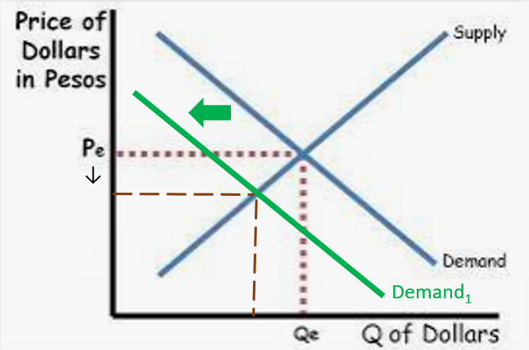
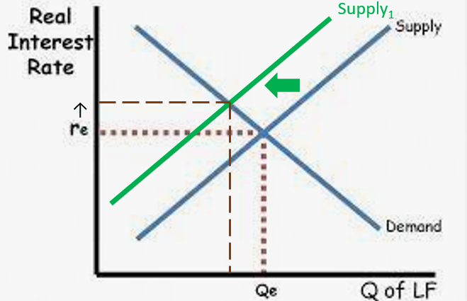
Lower Interest Rates and Capital Outflows
Capital outflows mean decreased demand in the foreign exchange market.
Lower interest rates lead to capital outflows.
Investors move their money to where it will earn higher interest
Lower interest can be caused by multiple factors but also includes FP and MP:
Contractionary Fiscal Policy
↓G↑T→ ↓Government Borrowing→ ↓D_{LF} → ↓Interest Rate (Loanable Funds Mkt)
Expansionary Monetary Policy
↑MS→ ↓ Interest Rate (Money Mkt)
Note: Interest Rates in an economy largely move together. So RIR and NIR can both be treated as IR.
Capital outflows mean less supply in the loanable funds market.

Slide 43
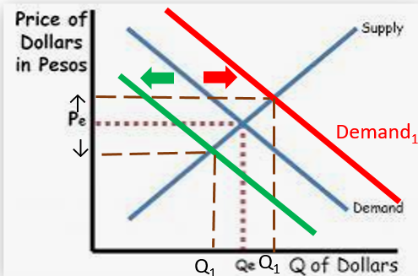
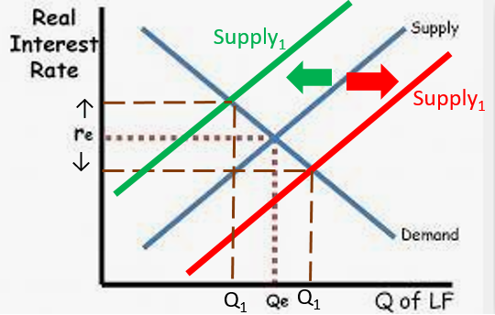
Two Consequences of Capital Inflows / Outflows
Consequence 1: Net Exports and AD
Capital Inflows→↑Demand for currency →↑Exchange Rate →↓Net Exports →↓AD
Capital Outflows→↓Demand for currency →↓Exchange Rate →↑Net Exports →↑AD
Consequence 2: Capital Formation
Capital inflows→↑Supply Loanable Funds →↑Private borrowing and investment →↑Capital Formation
Capital Outflows→↓Supply Loanable Funds →↓Private borrowing and investment →↓Capital Formation

Slide 44
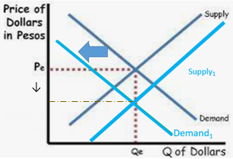
Exchange Rate affects Net Exports, affects AD
Summary
↓Exchange Rate →↑(X-M) →↑AD
↑Exchange Rate → ↓(X-M) → ↓ AD
Capital Inflows→ ↑Demand for currency, ↓ Supply currency→↑Exchange Rate will lead to a fall in Net exports (↑imports↓exports)
This will lead to a fall in AD.
Capital Outflows→ ↓Demand for currency→ ↓Exchange Rate will lead to a increase in net exports (↑exports↓imports).
This will lead to an increase in AD.
This effect on AD will then have an effect on Output (Y) and Unemployment.

Slide 45
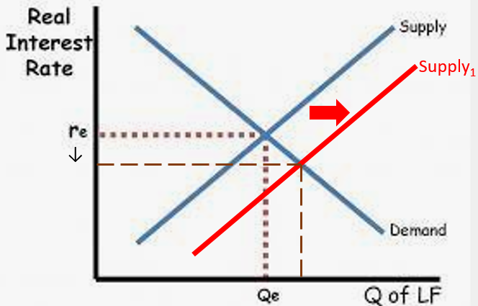
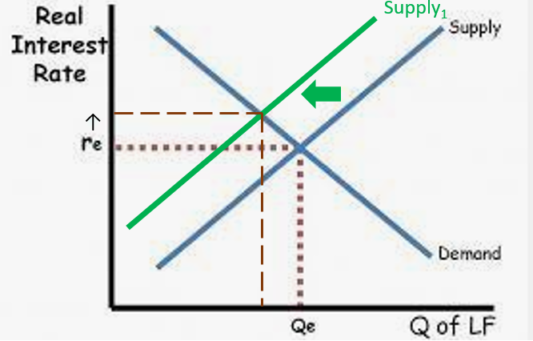



Summary:
FP and MP and effect on Capital Formation
Expansionary Fiscal Policy
↑G↓T→↑Government Borrowing→↑D_{LF} →↑Interest Rate (Loanable Funds Mkt)
Contractionary Monetary Policy
↓MS→↑Interest Rate (Money Mkt)
Contractionary Fiscal Policy
↓G↑T→ ↓Government Borrowing→ ↓DLF → ↓Interest Rate (Loanable Funds Mkt)
Expansionary Monetary Policy
↑MS→ ↓ Interest Rate (Money Mkt)
↑Net Capital Inflows
Capital Outflows
Capital Formation
Capital Formation
→ ↑Investment→ ↑ Capital Formation
→↓Investment→↓Capital Formation
↑S_{LF}→ ↑Private Borrowing
↓S_{LF}→↓Private Borrowing
LESS Economic Growth
More Economic Growth
Note: The growth rate will be slower but not necessarily negative.
Note: The growth rate will be slower but not necessarily negative.

Slide 46
‘Chains of Events’
6.4: FP, MP and Exchange Rates
Expansionary fiscal policy→↑Real Interest Rate (crowding out) →↑Capital Inflows→↑Exchange Rate
Expansionary MP →↑MS→↓Interest Rate→↓Capital Flows→↓Demand for the currency →↓Exchange Rate
6.5: ER and Net Exports
↑Exchange Rate will lead to a fall in Net exports (↑imports↓exports)
This will lead to a fall in AD.
↓Exchange Rate will lead to a increase in net exports (↑exports↓imports).
This will lead to an increase in AD.
6.6 Capital Inflows and Capital Formation
Capital Inflows→↑Demand for currency →↑Exchange Rate →↓Net Exports →↓AD
Capital inflows→↑Supply Loanable Funds →↑Private borrowing and investment →↑Capital Formation
Expansionary fiscal policy→↑Real Interest Rate (crowding out)
→↑Capital Inflows→
↑Exchange Rate
→↑Supply Loanable Funds →↑Private borrowing and investment →↑Capital Formation
Contractionary Monetary Policy
→↓MS→↑Interest Rate (Money Mkt)
Note: For Contractionary Fiscal Policy and Expansionary MP, the same chain but opposite effects.
→↓Net exports (↑imports↓exports)→↓AD

Slide 47
Exchange Rate Summaries

Slide 48
Exchange Rate Summary
Appreciation = ↑Purchasing Power
Who benefits:
People travelling to other countries
People buying imports
People investing in other countries
People on fixed incomes, living overseas.
Depreciation = ↓Purchasing Power
Who benefits:
Exporters whose goods are now cheaper for foreigners
Foreign investors in the country
The exchange rate is simply the value of currency A relative to another currency B.
Eg. 1 USD = 6.5RMB or 1RMB = 0.15USD
Fixed = the government controls the exchange rate
Floating = the government allows market forces to decide the exchange rate
Appreciate = go up in value eg. RMB can buy more AUD
Depreciate = go down in value eg. RMB can buy less AUD

Slide 49

Foreign Exchange Market Summary
The Foreign Exchange Market (Forex market) is where currencies are exchanged and determines the exchange rate/price of currency.
Fixed Exchange rate = exchange rate is constant
Floating exchange rate = moves up and down via market forces
Appreciation
Change in Equilibrium: ↑Demand→↑Price↑Quantity
↓Demand→↓Price↓Quantity
↑Supply→↓Price↑Quantity
↓Supply→↑Price↓Quantity
∆Demand & ∆Supply = either Price or Quantity indeterminate
Depreciation = ↓Purchasing Power → ↓Imports ↑Exports
→Benefits for foreigners buying your currency
Appreciation = ↑Purchasing Power →↑Imports ↓Exports
→Benefits for those buying foreign currencies
Depreciation
Determinants of Demand AND Supply
Tastes and Preferences
Income Level
Interest Rates(affects D and S)
Price Level (Inflation) (affects D and S)
Trade Policies (eg. Taxes on imports)
Expectations of Future Exchange Rate
Surplus and shortage occurs when the price is too high or low.
↑Supply Currency A=↑Demand Currency B and vice versa.

Slide 50
1st, 2nd, 3rd effects etc.
The first increase in AD will outweigh the reduction in AD.
↑AD→↓X-M (wealthier people buy more imports →↓AD
Does this mean that AD is unchanged?
No, AD will increase overall, because the 1st effect will be stronger than the 2nd effect.
↓Exchange Rate (lower demand for currency) →↑X-M (imports more expensive for locals, exports cheaper for foreigners) → ↑Exchange Rate
Again, the 1st effect of the Exchange Rate Effect will be larger than the 2nd effect
Summary
The 1st effect of a movement > the 2nd effect, → a net movement the same as the 1st movement.
The first change in D will outweigh the second change in D.

Slide 51
Government Policy, Capital Flows and Exchange Rates
Summary
Expansionary FP→↑Exchange Rate
Expansionary MP→↓Exchange Rate
Expansionary fiscal policy→↑Real Interest Rate (crowding out) →↑Capital Inflows→↑Exchange Rate
Expansionary MP →↑MS→↓Interest Rate→↓Capital Flows→↓Demand for the currency →↓Exchange Rate

Slide 52
Exchange Rate affects Net Exports, affects AD
Summary
↓Exchange Rate →↑(X-M) →↑AD
↑Exchange Rate → ↓(X-M) → ↓ AD
↑Exchange Rate will lead to a fall in Net exports (↑imports↓exports)
This will lead to a fall in AD.
↓Exchange Rate will lead to a increase in net exports (↑exports↓imports).
This will lead to an increase in AD.
This effect on AD will then have an effect on Output (Y) and Unemployment.

Slide 53
Two Consequences of Capital Inflows / Outflows
↑↓
Consequence 1: Net Exports and AD
Capital Inflows→↑Demand for currency →↑Exchange Rate →↓Net Exports →↓AD
Capital Outflows→↓Demand for currency →↓Exchange Rate →↑Net Exports →↑AD
Consequence 2: Capital Formation
Capital inflows→↑Supply Loanable Funds →↑Private borrowing and investment →↑Capital Formation
Capital Outflows→↓Supply Loanable Funds →↓Private borrowing and investment →↓Capital Formation

Slide 54
‘Chains of Events’
6.4: FP, MP and Exchange Rates
Expansionary fiscal policy→↑Real Interest Rate (crowding out) →↑Capital Inflows→↑Exchange Rate
Expansionary MP →↑MS→↓Interest Rate→↓Capital Flows→↓Demand for the currency →↓Exchange Rate
6.5: ER and Net Exports
↑Exchange Rate will lead to a fall in Net exports (↑imports↓exports)
This will lead to a fall in AD.
↓Exchange Rate will lead to a increase in net exports (↑exports↓imports).
This will lead to an increase in AD.
6.6 Capital Inflows and Capital Formation
Capital Inflows→↑Demand for currency →↑Exchange Rate →↓Net Exports →↓AD
Capital inflows→↑Supply Loanable Funds →↑Private borrowing and investment →↑Capital Formation
Expansionary fiscal policy→↑Real Interest Rate
→↑Capital Inflows→
↑Exchange Rate
→↑Supply Loanable Funds →↑Private borrowing and investment →↑Capital Formation
Contractionary Monetary Policy
→↓MS→↑Interest Rate (Money Mkt)
Note: For Contractionary Fiscal Policy and Expansionary MP, the same chain but opposite effects.
→↓Net exports (↑imports↓exports)→↓AD

Slide 55
Unit 6 Summary
6.1 | Balance of Payments
6.2 | Exchange Rates
6.3 | Exchange Rate Market
6.4 | FP and MP effect on Exchange Rates
6.5 | Exchange Rates and Net Exports
6.6 | Bringing it all together

Slide 56
Unit 6 Summary
6.1 | Balance of Payments | Current Account: Net exports, Net Income, Net Transfers Capital and Financial Account: Net investment (financial and real) CA + CFA = 0
6.2 | Exchange Rates | Exchange Rate: Amount of currency A needed to buy currency B Appreciation: Currency goes up in value and purchasing power increases Depreciation: Currency goes down in value and purchasing power decreases
6.3 | Exchange Rate Market | Demand, Supply, Equilibrium, Shortage, Surplus Determinants of Demand/Supply: Preferences, Income, Interest Rates, Trade policies, Expectations etc.
6.4 | FP and MP effect on Exchange Rates | Expansionary fiscal policy→↑Real Interest Rate (crowding out) →↑Capital Inflows→↑Exchange Rate Expansionary MP →↑MS→↓Interest Rate→↓Capital Flows→↓Demand for the currency →↓Exchange Rate
6.5 | Exchange Rates and Net Exports | ↑Exchange Rate →↓Net exports (↑imports↓exports)→↓ AD
6.6 | Bringing it all together | Capital Inflows→↑Demand for currency →↑Exchange Rate →↓Net Exports →↓AD Capital inflows→↑Supply Loanable Funds →↑Private borrowing and investment →↑Capital Formation

